Slide 1
Review
List Data Structure
List operations
List Implementation
Array
Linked List

Slide 2
Pointer
Pointer
Pointer Variables
Dynamic Memory Allocation
Functions

Slide 3
What is a Pointer?
A Pointer provides a way of accessing a variable without referring to the variable directly.
The mechanism used for this purpose is the address of the variable.
A variable that stores the address of another variable is called a pointer variable.

Slide 4
Pointer Variables
Pointer variable: A variable that holds an address
Can perform some tasks more easily with an address than by accessing memory via a symbolic name:
Accessing unnamed memory locations
Array manipulation
etc.

Slide 5
Why Use Pointers?
To operate on data stored in an array
To enable convenient access within a function to large blocks data, such as arrays, that are defined outside the function.
To allocate space for new variables dynamically–that is during program execution

Slide 6
Pointer Data Types and Pointer Variables
Pointer variable: variable whose content is a memory address
Syntax to declare pointer variable:
dataType *identifier;
Address of operator: Ampersand, &
Dereferencing operator/Indirection operator: Asterisk, *

Slide 7
The Address-Of Operator (&)
The address-of operator, &, is a unary operator that obtains the address in memory where a variable is stored.
int number = 1234;
int*pnumber= &number; //stores address of //number in pnumber
char a = „a‟;
char *pa = &a;//stores address of a in pa.

Slide 8
The Indirection Operator
How pointer variable is used to access the contents of memory location?
The indirection operator, *is used for this purpose.
cout<< *pnumber;

Slide 9
The Indirection Operator
int x= 4;
int *px = &x; //stores address of variable x in variable px
Addresses
cout<<“The number is:”<<x;
Addresses
x
4
1310
x
4
1310
The output is:
The number is: 4
1312
1312
1314
px
1310
1314
1316
1316
cout<<“The number accessed by pointer variable is: ”<<*px
The output is:
The number is: 4

Slide 10
The Indirection Operator
int x= 4;
int *px = &x; //stores address of variable x in variable px
Addresses
x
3
4
1310
1312
px
1310
1314
1316
*px = 3 //This statement means assign 3 to a variable “pointed to” by px.
The data is accessed indirectly

Slide 11
Pointer Representation
int x = 10;
int *p;
p = &x;
p gets the address of x in memory.
p
10
x
Notes:
11
Much like a java reference (but more explicit)
A pointer is a variable that contains the address of an object in memory.
Line 1 – x is an integer, give it value 10
Line 3 – p gets the address of x

Slide 12
Example
int x = 10;
int *p;
p = &x;
*p = 20;
*p is the value at the address p.
p
20
x
Notes:
12

Slide 13
What is a pointer?
Declares a pointer
to an integer
int x = 10;
int *p;
p = &x;
*p = 20;
& is address operator
gets address of x
* dereference operator
gets value at p
Notes:
13

Slide 14
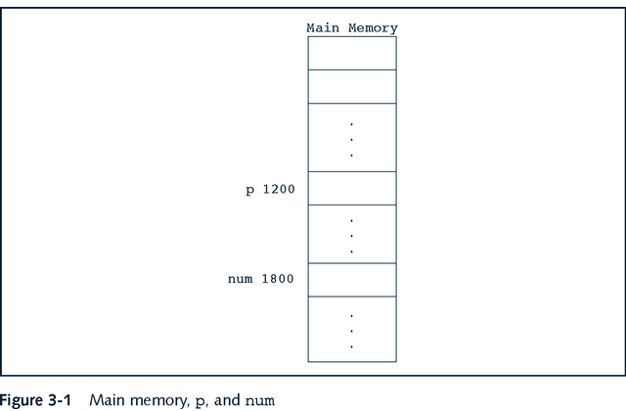
Pointers Memory Representation
Statements:
int *p;
int num;

Slide 15
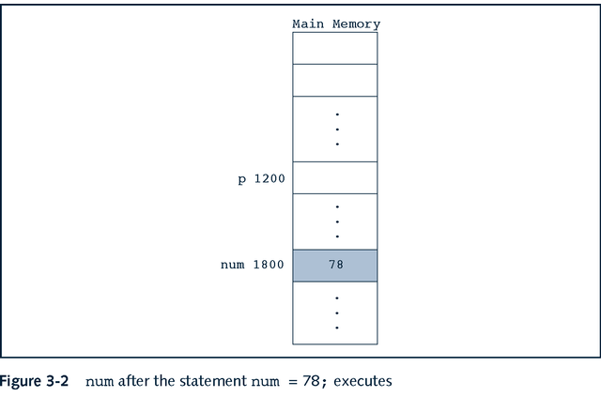
cont…

Slide 16
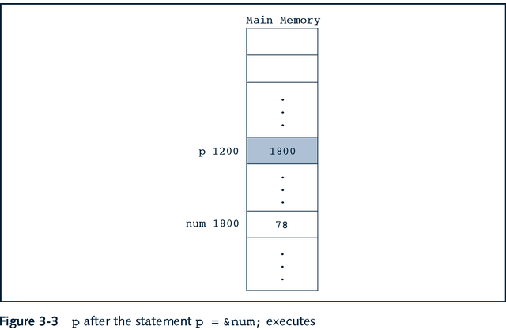
cont…

Slide 17
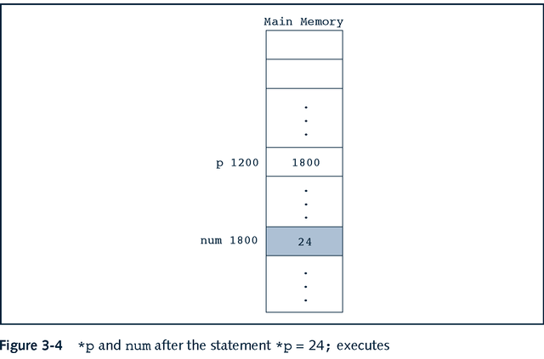
cont…

Slide 18
Pointers
Summary of preceding diagrams
&p, p, and *p all have different meanings
&p means the address of p
p means the content of p
*p means the content pointed to by p, that is pointed to by the content of memory location

Slide 19
Getting the Address of a Variable
Each variable in program is stored at a unique address
Use address operator & to get address of a variable:
int num = 23;
cout << &num;
// prints address
// in hexadecimal

Slide 20
Pointer Variables
Definition:
int *intptr;
Read as:
“intptr can hold the address of an int”
Spacing in definition does not matter:
int *intptr; // same as above
int* intptr; // same as above

Slide 21
Pointer Variables
Assignment:
int *intptr;
intptr = &num;
Memory layout:
Can access num using intptr and indirection operator *:
cout << *intptr << endl;
num
intptr
25
0x4a00
address of num: 0x4a00

Slide 22
Assigning a value to a dereferenced pointer
A pointer must have a value before you can dereference it (follow the pointer).
int *x;
*x=3;
int foo;
int *x;
x = &foo;
*x=3;
ERROR!!!
x doesn’t point to anything!!!
this is fine
x points to foo

Slide 23
Pointers to anything
x
some int
int *x;
int **y;
double *z;
y
some *int
some int
z
some double

Slide 24
The Relationship Between Arrays and Pointers
Array name is starting address of array
int vals[] = {4, 7, 11};
cout << vals;
cout << vals[0];
starting address of vals: 0x4a00
4 | 7 | 11
// displays
0x4a00
// displays 4

Slide 25
Pointers and Arrays
An array name is basically a const pointer.
You can use the [] operator with a pointer:
int *x;
int a[10];
x = &a[2];
x is “the address of a[2] ”

Slide 26
Pointer Arithmetic
Operations on pointer variables:
Operation | Example int vals[]={4,7,11}; int *valptr = vals;
++, -- | valptr++; // points at 7 valptr--; // now points at 4
+, - (pointer and int) | cout << *(valptr + 2); // 11
+=, -= (pointer and int) | valptr = vals; // points at 4 valptr += 2; // points at 11
- (pointer from pointer) | cout << valptr–val; // difference //(number of ints) between valptr // and val

Slide 27
Pointer arithmetic
Integer math operations can be used with pointers.
If you increment a pointer, it will be increased by the size of whatever it points to.
int *ptr = a;
*(ptr+2)
*(ptr+4)
*ptr
a[0] a[1] a[2] a[3] a[4]
int a[5];

Slide 28
Initializing Pointers
Can initialize at definition time:
int num, *numptr = &num;
int val[3], *valptr = val;
Cannot mix data types:
float cost;
int *ptr = &cost; // won’t work

Slide 29
Comparing Pointers
Relational operators (<, >=, etc.) can be used to compare addresses in pointers
Comparing addresses in pointers is not the same as comparing contents pointed at by pointers:
if (ptr1 == ptr2) // compares
// addresses
if (*ptr1 == *ptr2) // compares
// contents

Slide 30
Operator new and new[]
In order to request dynamic memory we use the operator new.
new is followed by a data type specifier
pointer = new type
if a sequence of more than one element is required- the number of these are given within brackets [].
pointer = new type [number_of_elements]

Slide 31
cont…
It returns a pointer to the beginning of the new block of memory allocated.
int * ptr;
ptr = new int [5];
In this case, the system dynamically assigns space for five elements of type int and returns a pointer to the first element of the sequence, which is assigned to ptr. Therefore, now, ptr points to a valid block of memory with space for five elements of type int.

Slide 32
cont…
The first element pointed by ptr can be accessed either with the expression ptr[0] or the expression *ptr. Both are equivalent.
The second element can be accessed either with ptr[1] or *(ptr+1) and so on...

Slide 33
Operator delete and delete[]
Since the necessity of dynamic memory is usually limited to specific moments within a program, once it is no longer needed it should be freed so that the memory becomes available again for other requests of dynamic memory. This is the purpose of the operator delete, whose format is:
delete pointer;
delete [] pointer;

Slide 34
cont…
The first expression should be used to delete memory allocated for a single element, and the second one for memory allocated for arrays of elements.
The value passed as argument to delete must be either a pointer to a memory block previously allocated with new, or a null pointer (in the case of a null pointer, delete produces no effect).

Slide 35
#include <iostream>
int main ()
{ int i,n;
int * p;
cout << "How many numbers would you like to type? ";
cin >> i;
p= new int[i];
for (n=0; n<i; n++)
{
cout << "Enter number: ";
cin >> p[n]; }
cout << "You have entered: ";
for (n=0; n<i; n++)
cout << p[n] << ", ";
delete[] p;
}
return 0;
}

Slide 36
How many numbers would you like to type? 5
Enter number : 75
Enter number : 436
Enter number : 1067
Enter number : 8
Enter number : 32
You have entered: 75, 436, 1067, 8, 32,

Slide 37
Dynamic Memory Allocation
DMA provides a mechanism to allocate memory at run-time by the programmer
Memory is a Free Store
During execution of program, there is unused memory in the computer. It is called free store.
Dynamic Storage duration
Life-span of dynamic variables is defined by the programmer
The Operators new and delete are used for DMA

Slide 38
Void Pointer
A void* is a generic pointer. Pointer of any type can be assigned to the void pointer
Once assigned the type of void* is the same as that of assigned pointer type
Dereferencing a void* is a syntax error
void* sPtr; int num;
int z[3]={1,2,3};
sPtr= z;
num= *sPtr; // ERROR
num= *(int*) sPtr; // correct version

Slide 39
Functions
Pass by value
A copy of argument it created
The value of the passed argument is not modified
The operation is performed on the copy of passed value as argument
Pass by reference
The address of argument is passed
The value of the passed argument gets modified
This may occur by Reference variable or through pointer variables

Slide 40
Pointer Parameters
Pointers are passed by value (the value of a pointer is the address it holds).
If we change what the pointer points to the caller will see the change.
If we change the pointer itself, the caller won't see the change (we get a copy of the pointer)

Slide 41
Pointers as Function Parameters
A pointer can be parameter
Works like reference variable to allow change to argument from within function
Requires:
asterisk * on parameter in prototype and heading
void getNum(int*); // function prototype
void getNum(int *ptr) // function header
// ptr is pointer to an int
asterisk * in body to dereference the pointer
cin >> *ptr;
address as argument to the function
getNum(&num); // pass address of num to getNum

Slide 42
Pointers as Function Parameters
void swap(int *x, int *y)
{ int temp;
temp = *x;
*x = *y;
*y = temp;
}
int num1 = 2, num2 = 3;
swap(&num1, &num2);

Slide 43
Passing pointers as arguments
When a pointer is passed as an argument, it divulges an address to the called function, so the function can change the value stored at that address:
void passPointer(int* iPtr){
*iPtr += 2;
}
...
int i = 3;
int* iPtr = &i;
passPointer(iPtr);
cout << "i = " << i << endl; // prints i = 5
passPointer(&i); // equivalent to above
cout << "i = " << i << endl; // prints i = 7

Slide 44
Summary
Pointer
Pointer Variables
Dynamic Memory Allocation
Functions

